Slide 1
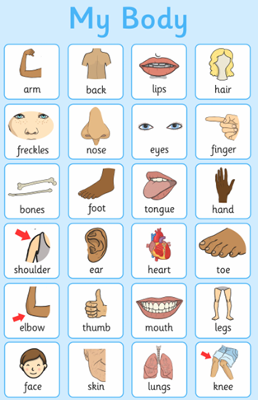
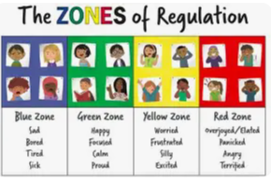



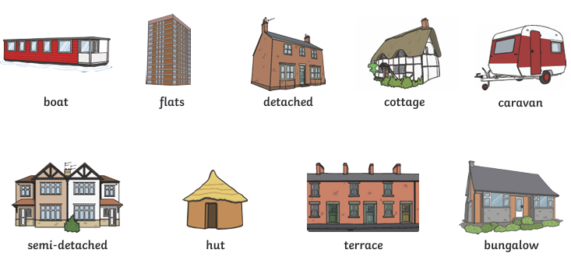


Topic: Me and My World Autumn 1 Year A
My World
I know who is in my family/lives in my house
I can use the vocabulary of family - mum, dad, brother, sister, grandparents, aunties, uncles, cousins
I can name different kinds of houses
I can talk about how houses have changed from the past
I know what shops and buildings are in my local community of Shieldfield eg bakery, park, school, Christ church, metro,
Ourselves
I can name the parts of my body
I can name the 5 senses and how I use them everyday
I can talk about the changes that have happened to me since I was a baby
I can talk about my feelings
I can talk about the colours in the zones of regulation
Settling In
Much of this term will be used to settle in, learn rules and routines, carry out Baseline assessment in Reception

