Slide 1







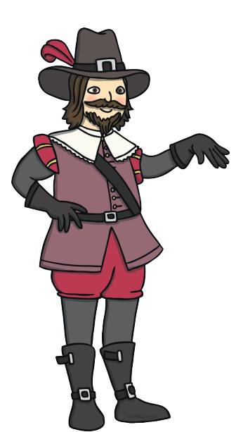

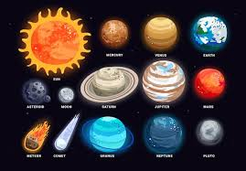


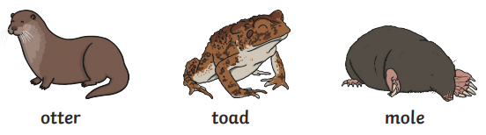

Autumn 2 Year A: Fizz, Bang, Whizz
Talk about Guy Fawkes and the Gunpowder Plot
Know about the British tradition of Bonfire Night
I can talk about being safe with fireworks and sparklers
I can name some natural light – sun, moon, stars, rainbows, fire, lightening
I can name some man-made light – lamps, torches, tv, fireworks
I know nocturnal animals sleep in the day and are awake at night
I can name some nocturnal animals
I can sort activities by day or night
I can investigate shadows
I know I live on the planet Earth
I can name some planets
I know astronauts travel to the moon and space
I know Neil Armstrong was the first man on the moon

