Slide 1
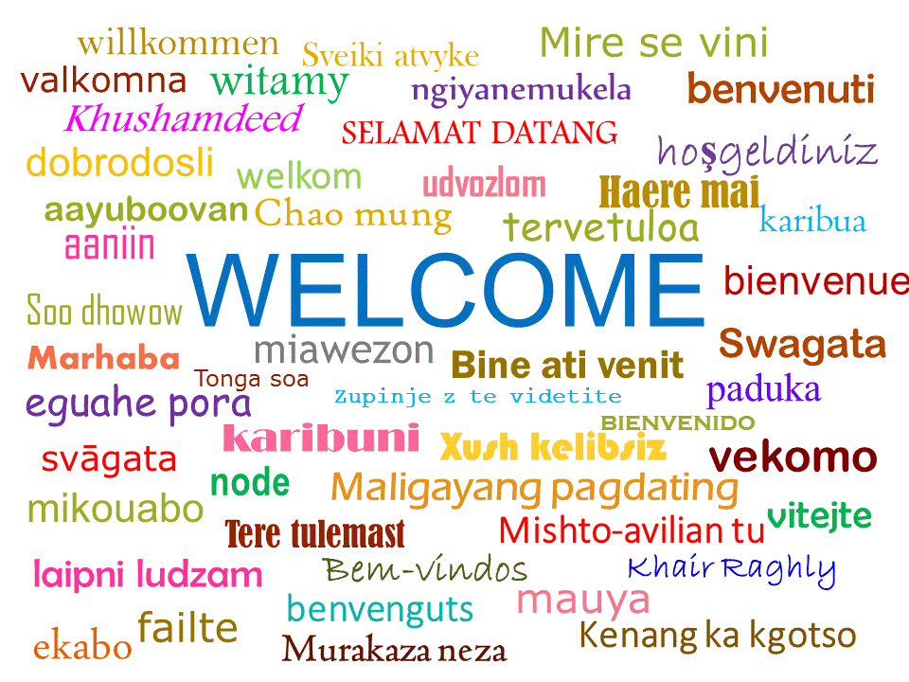
Welcome to Christ Church CE Primary School. Thank you for coming to visit us.
We thought we would tell you a little about our school.

Slide 2
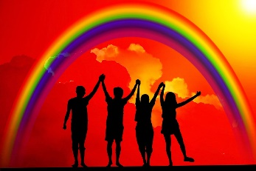
Our Vision Reach for the Stars – Living Life in all its fullness Thriving on diversity and underpinned by Christian values, Christ Church is an inclusive school where everyone is welcome and valued.
Today we have 152 children on roll. I say today because by the end of the week it will probably change.
We speak 25 different languages and we are all learning Spanish – Buenos dias.
Since January we have welcomed over 30 new friends to Christ Church from Iran, Iraq, El Salvador, Brazil and Ukraine.
(Ayma, Margo, Maksyum, Isaac,
Tara, Pietra, Wisdom, Lucas, Fulfil, Rawasi, D’jeinara)
Notes:
After the word Spanish, the whole school says Buenos dias.
Call out pupil names and they say in their language – My name is .. I am from … good morning.
Choose someone to say it in English too – Issac Stoman

Slide 3
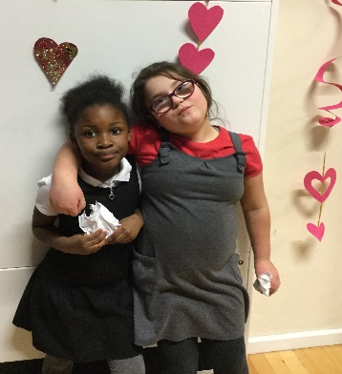
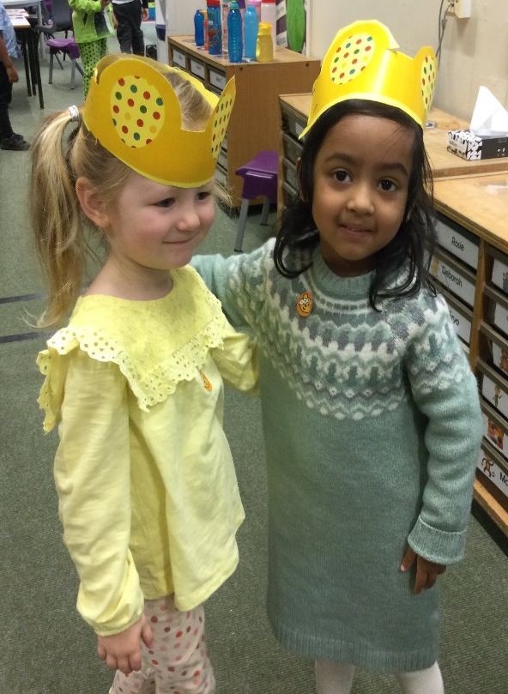
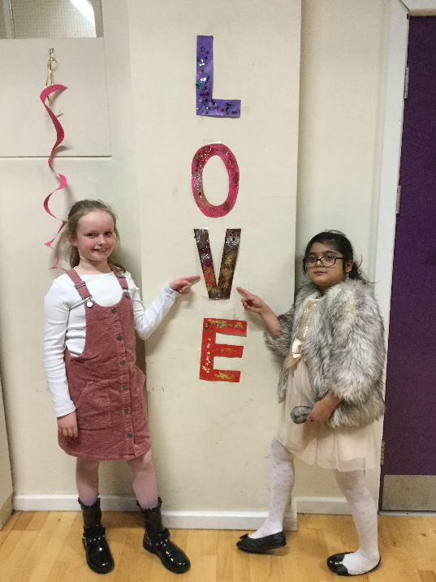
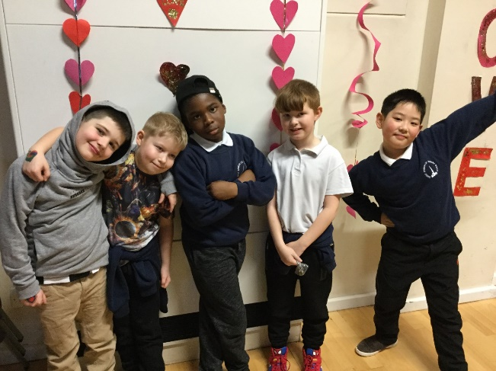
Our vision is to shepherd each other in a safe, loving environment, whilst building a solid foundation to encourage and inspire us to reach for our own star. (Tamin , Angeola, Ayma )
Notes:
Tamin, Angeola and Ayma give personal comments on being welcomed to CC and what they want to become.

Slide 4
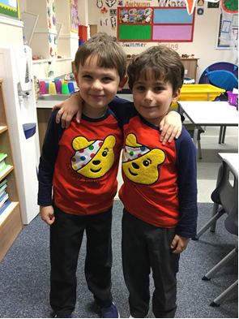
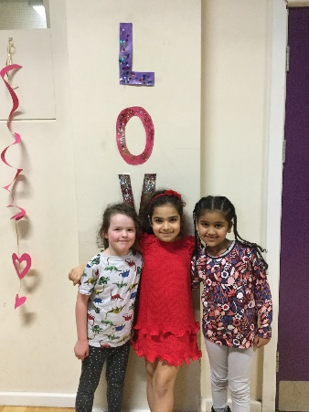
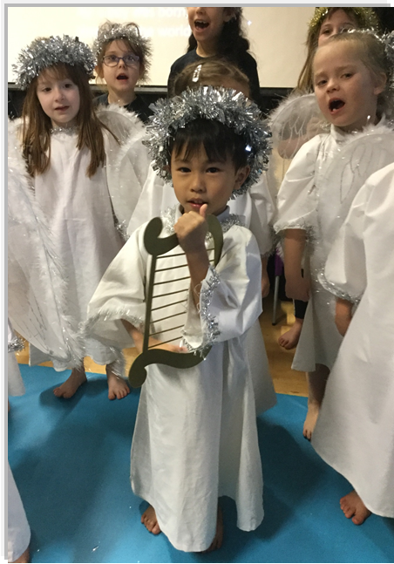
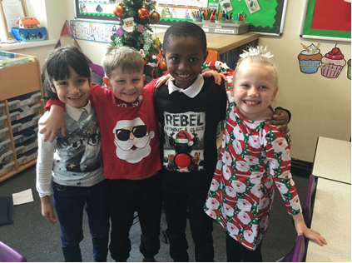
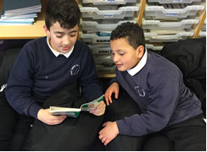
Values As a church school our foundations for living and learning are the life and teaching of Jesus Christ. The message of God’s love for all and the Christian values of respect, friendship, love, forgiveness, trust, and perseverance, are at the heart of all school life.
Notes:
Add photos showing love and friendship

Slide 5
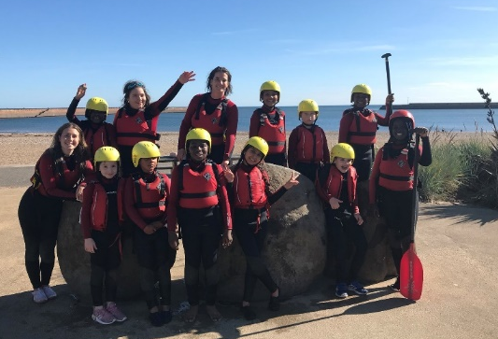
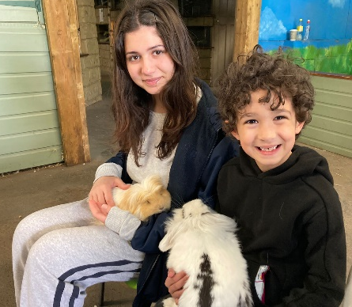
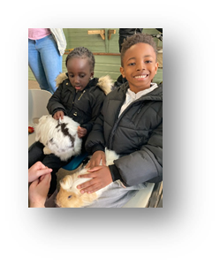
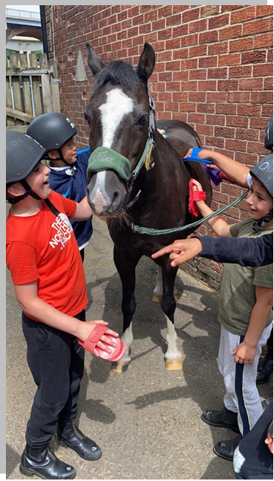
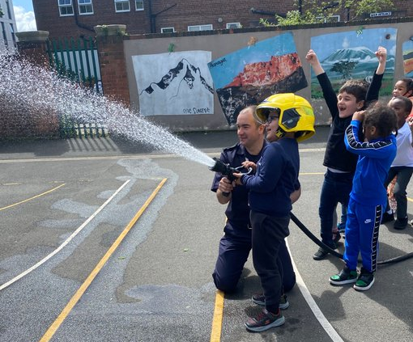
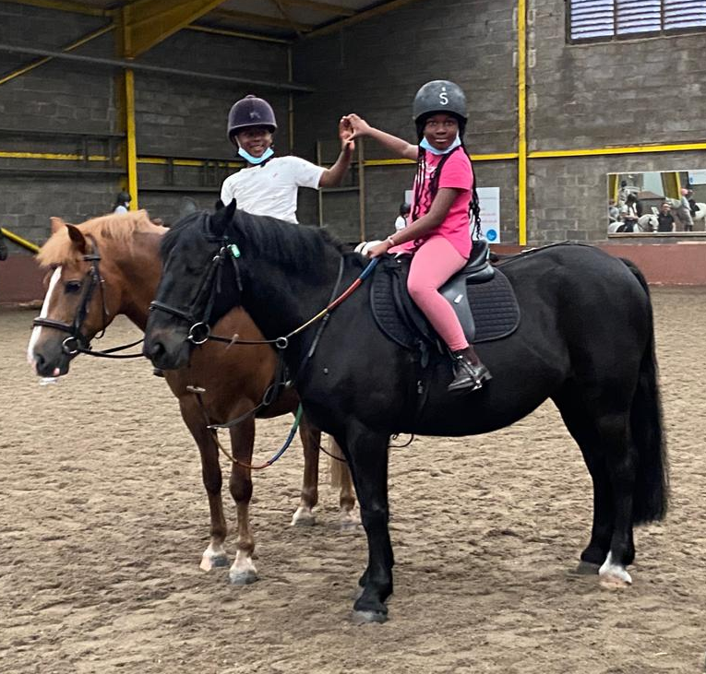
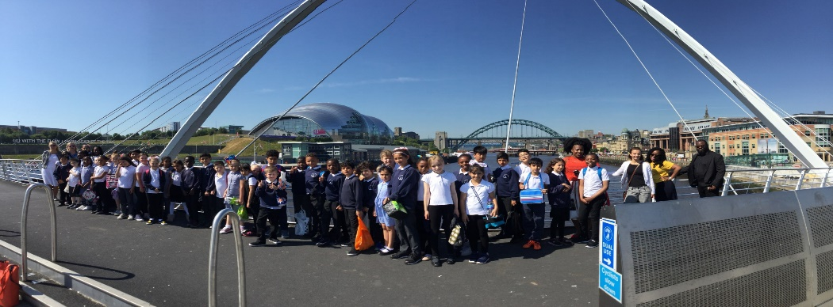
We experience the joy and wonder of learning through a creative and challenging curriculum using the local community and beyond which makes learning vivid, real, enjoyable and fun.
We, (most of us) love singing.
Notes:
Photos paddle boarding etc. Ask a couple of children what they have enjoyed/learning? Musa, Armis, Renato, Lucas
Sing I love the flowers.

Slide 6
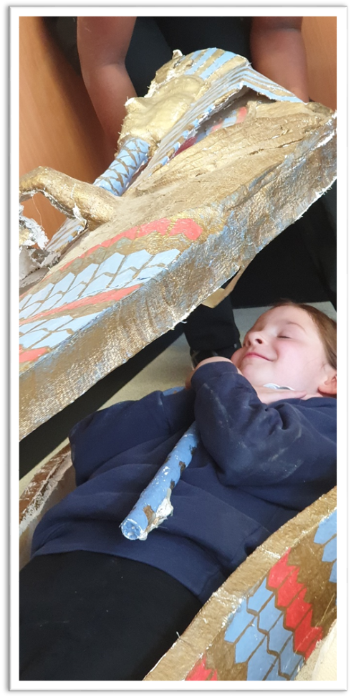
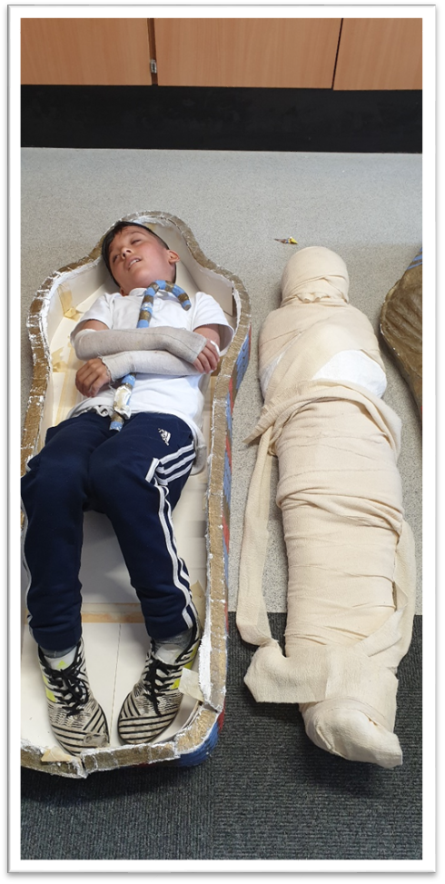
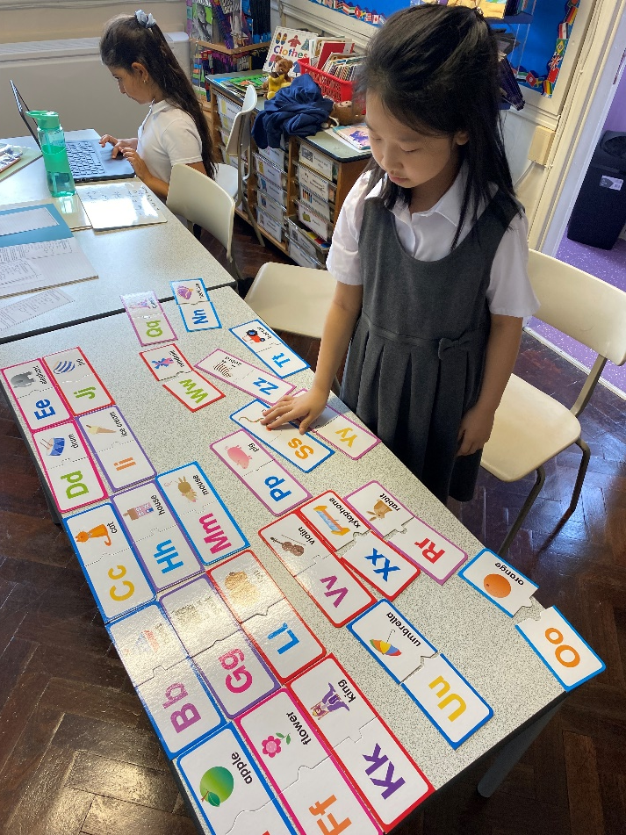
Our curriculum is designed to include the cultural, social and linguistic experiences of everyone. Our lessons are engaging, relevant and respectful.

Slide 7
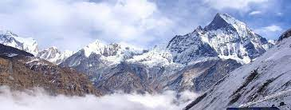
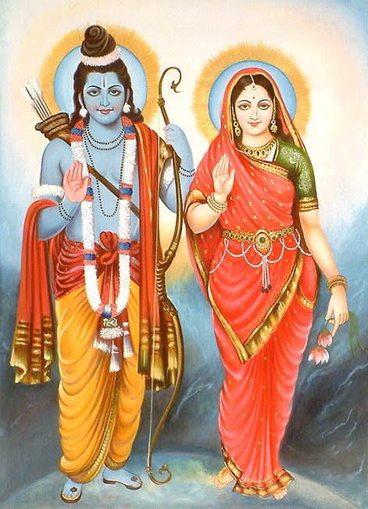
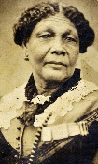
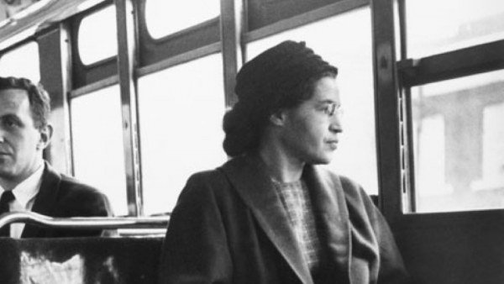
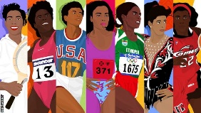
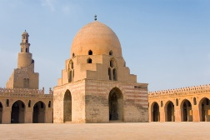
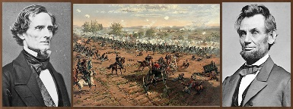
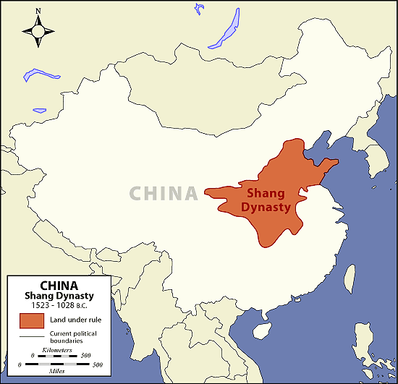
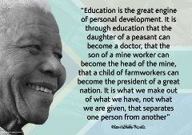
Notes:
Ask children - Do they recognise any of these pictures? What have they been learning?

Slide 8
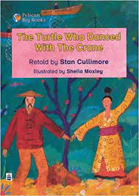
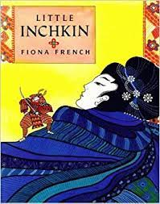
We love reading stories from other cultures and about other families’ customs and experiences.
Notes:
Ask children if they remember or recognise any of these books. Which ones did they enjoy and why? What did they learn?

Slide 9
We celebrate Chinese New Year. We learn about Buddhism and the art of paper folding - origami.
Notes:
Catherine, Godswill and Sophie - origami

Slide 10
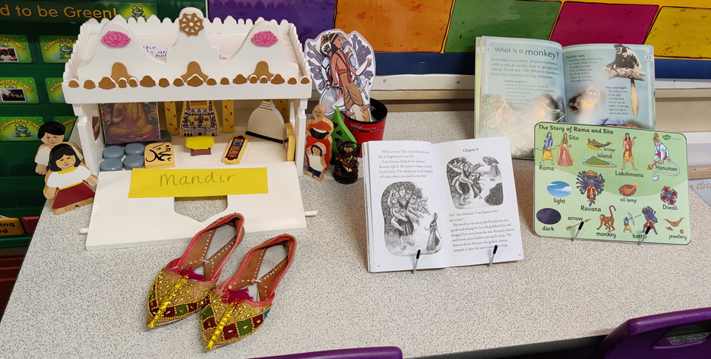
Diversity is reflected in the curriculum including in art, history, religion and dance. We learn about Indian culture and customs – Rangoli patterns, Hinduism and Bhangra.

Slide 11
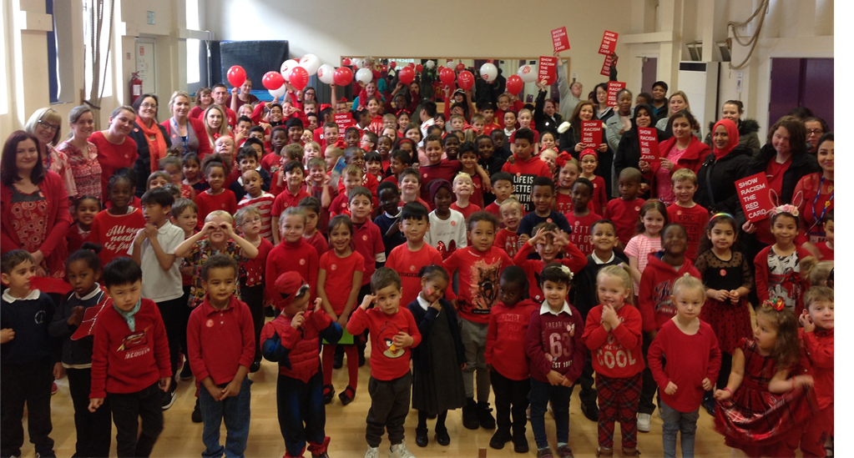
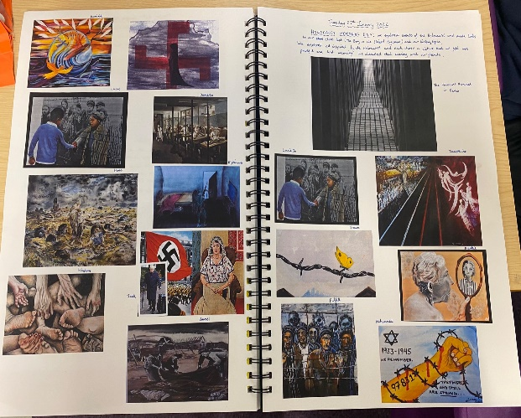
❖ We embrace difference where all children are equal. We cherish ourselves and each other and form healthy relationships offering respect, kindness and dignity. We develop a strong moral code, we aspire and we hope. We have opportunities to engage in social action and be courageous advocates for change in our local, national and global communities. Show Racism the Red Card Holocaust Day
Notes:
Show racism the red flag; Holocaust Day

Slide 12
We develop as independent learners with active and creative minds. We have opportunities to reflect and ask some of the “big questions “of life – Why do some people not have enough food, running water, a home? Why are we destroying the environment? Why do countries invade others? At Christ Church we are safe, loved and cared for but we know that conflict and war around the world continues every day. Please join us in our prayers for others.
Notes:
Lucas and Tercio come to the front. Celtic Prayer – followed by school prayer. Ask visitors for a prayer/blessing. Sing I have a small hand …
Play reach for the stars as we leave.

Slide 13
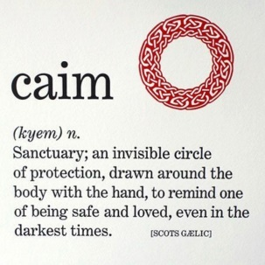
Celtic Prayer - Celtic Christians sometimes would use Caim prayers, pointing as they turned slowly on the spot, as a way of reminding themselves that they were surrounded by God’s love.
1. Circle me Lord. Keep protection near and danger afar
Be with Ukraine. Keep the people safe and keep danger away. (Lucas)
2.Circle me Lord. Keep light near and darkness afar
Be with Ukraine. Show them the light of your love so, it drives the darkness away.
3. Circle me Lord. Keep peace within, keep evil out.
Be with Ukraine. Bring peace, stop the war.
4. Circle me Lord. Keep hope within, keep doubt without.
Be with Ukraine. Give them hope and keep fear away.
School Prayer (Tercio)
Notes:
Sing I am a small part of the world. Bishop speaks. Play Reach for the Stars as we leave.

